Slide 1
Lecture 11
Topics
  Additional Design Techniques
    Distributed Connections
      Open Collector, Open Drain
      Dot AND
    Three State Outputs
    More on MUXs and Decoders/DMUXs
    More on XOR and XNOR

Slide 2
Distributed Connections

Slide 3
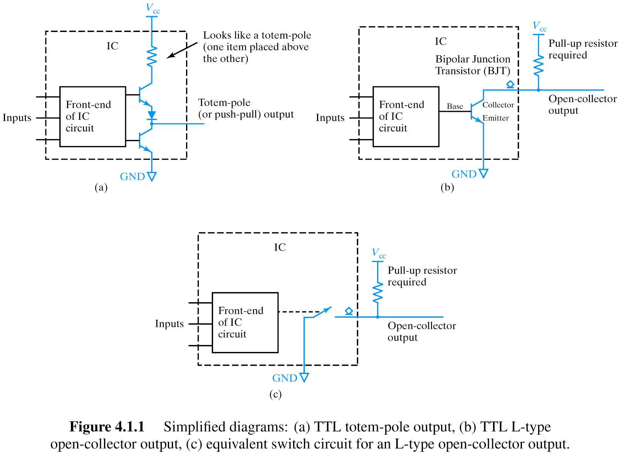
TTL Open Collector Outputs

Slide 4
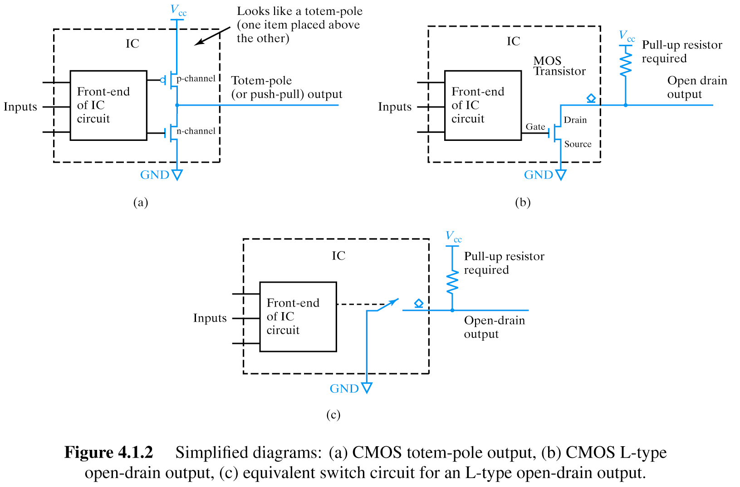
CMOS Open Drain Outputs

Slide 5
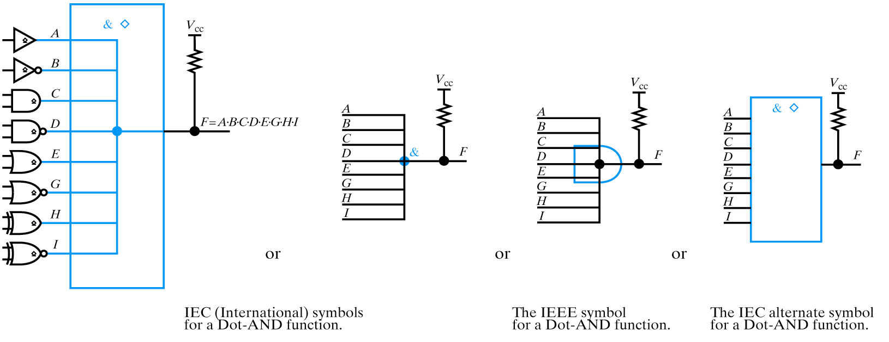
Wired AND (Dot AND)

Slide 6
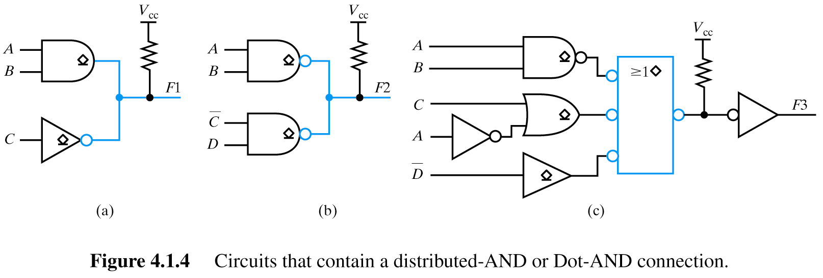
Wired AND Examples

Slide 7
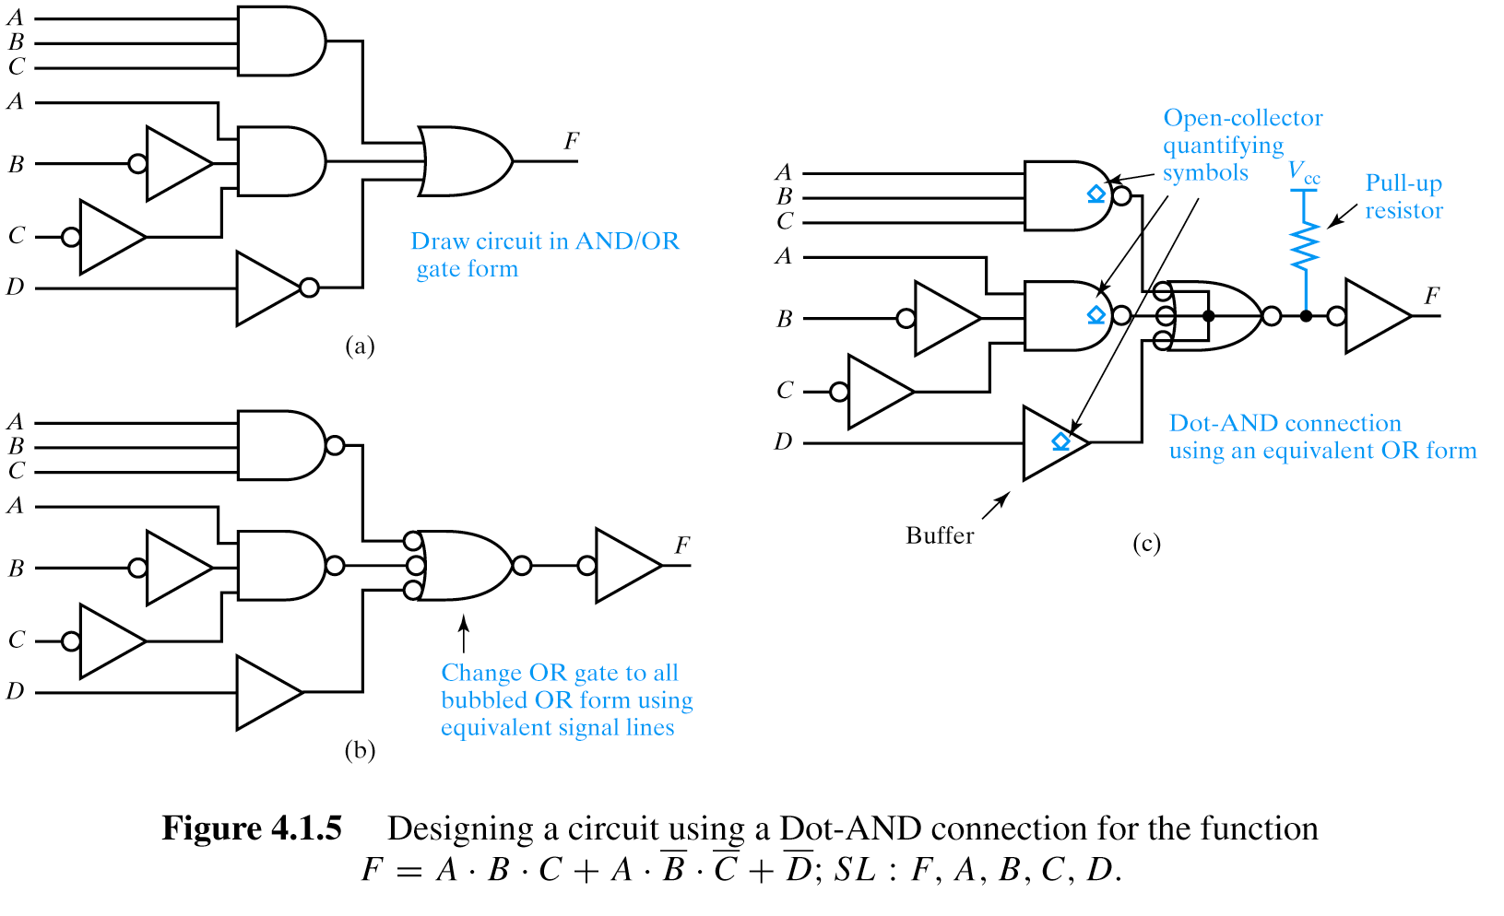
A Design Example with dot-AND connection
Bubbles on both inputs and outputs

Slide 8
A Design Example (cont)

Slide 9
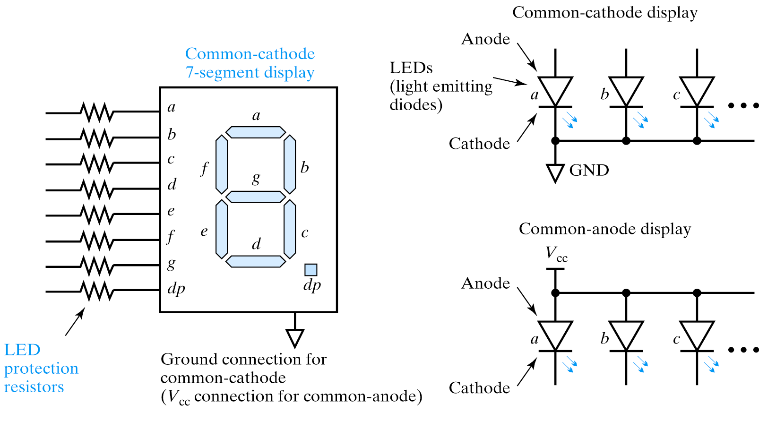
Using Open Drain Gate to Drive LEDs
Connect to open drain output

Slide 10
Three-State Outputs

Slide 11
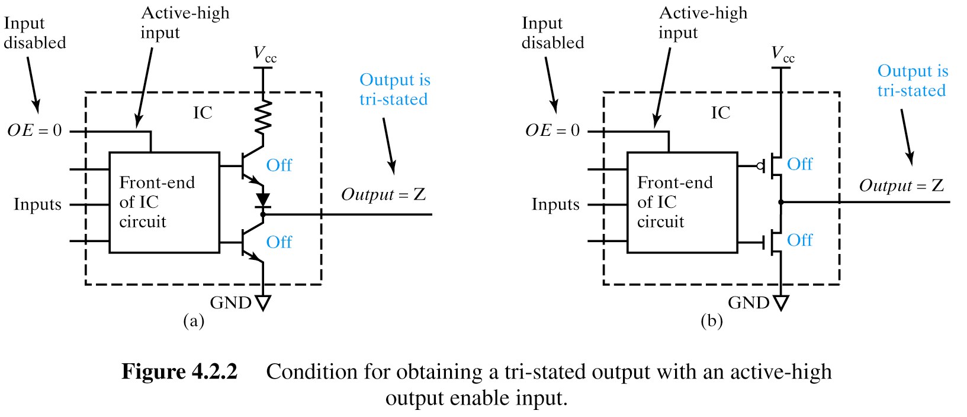
Three-State Outputs and the Disconnect State
TTL
CMOS
Floating Output
High Impedance
Tri-State® (National Semiconductor)
Use the “Z” character to denote this disconnect state
Notes:
Use the “Z” character to denote this disconnect state

Slide 12
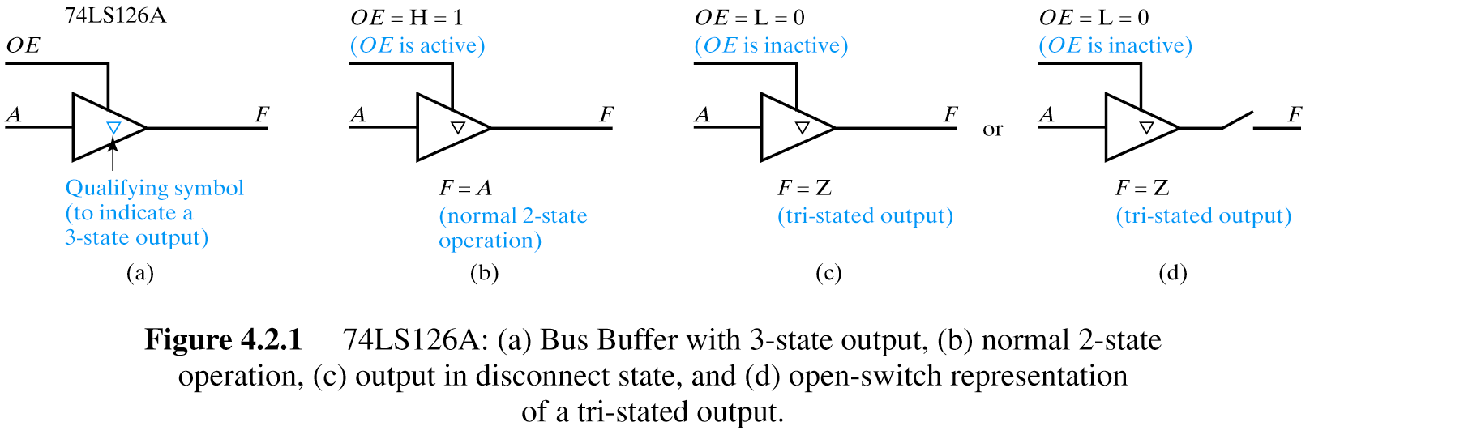

Tri-State® Buffers
OE F
0 Z
1 A
74LS126A Bus Buffer
OE F
0 B
1 Z
74LS125A Bus Buffer

Slide 13
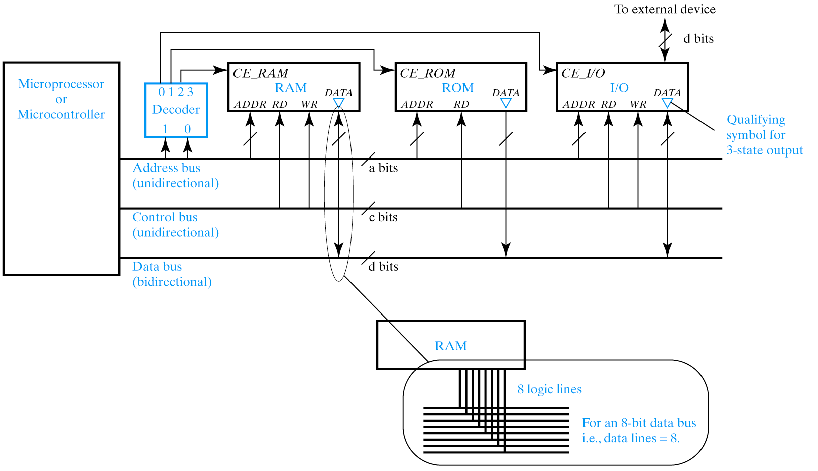
Data Bus Sharing

Slide 14
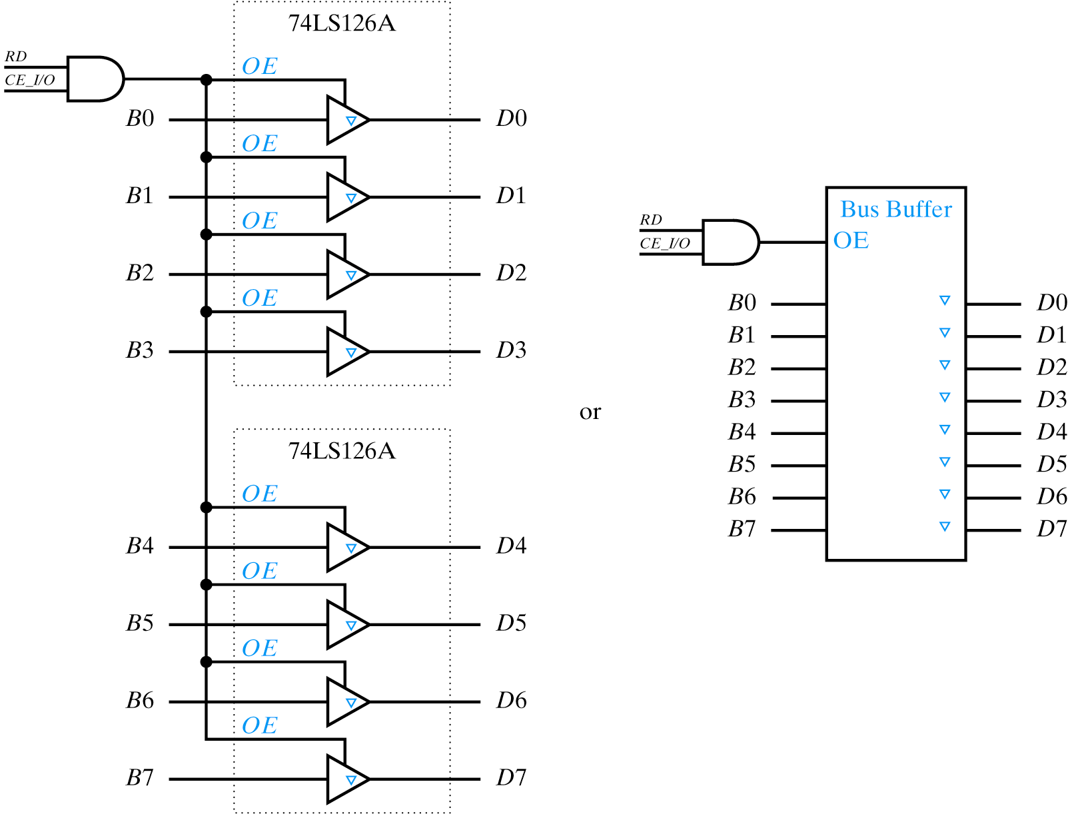
Bus Buffers
Show data sheets for LS126A and LS244

Slide 15
MUXs and Decoders/DMUXs
Notes:
MUXing a common technique for cost reduction in communications. MUX the data to fewer “channels” for transmission and then DMUX at the receiving end. (e.g. not practical to have a dedicated line for each “channel”).
Adopt a modular technique instead of gate-level and K-maps!

Slide 16
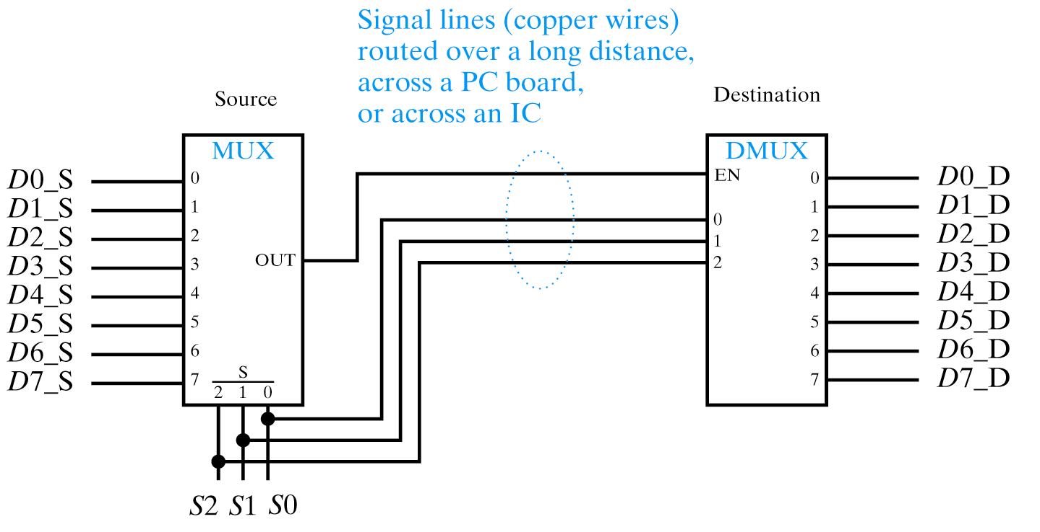
More About MUXs and Decoders/DMUXs

Slide 17
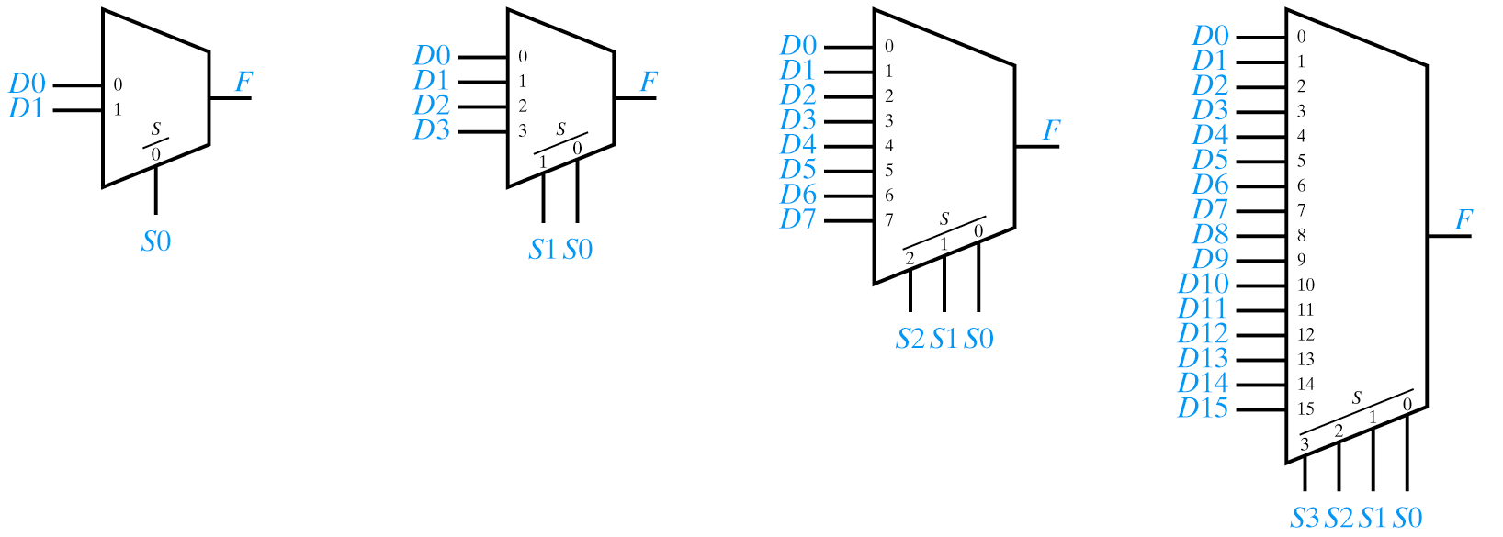
Off-the-shelf MUXs
MUXing a common technique for cost reduction in communications.
MUX the data to fewer “channels” for transmission and then DMUX at the receiving end.
  (e.g. not practical to have a dedicated line for each “channel”).
Adopt a modular technique instead of gate-level and K-maps!

Slide 18
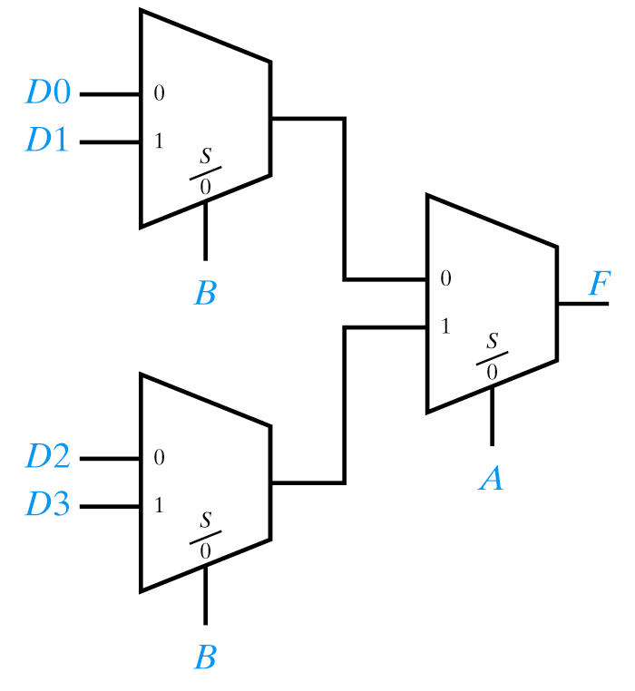
MUX Trees
A 4-to-1 MUX using 2-to-1 MUXs
Determine number of select inputs needed
2^{n} = 4, n = 2
List inputs and output in truth table order
A B F
Annotate with the bit weights
2 1
A B F
Reverse the order
2 1
A B F
1 2
Circled numbers indicate number of 2-to-1 muxs

Slide 19
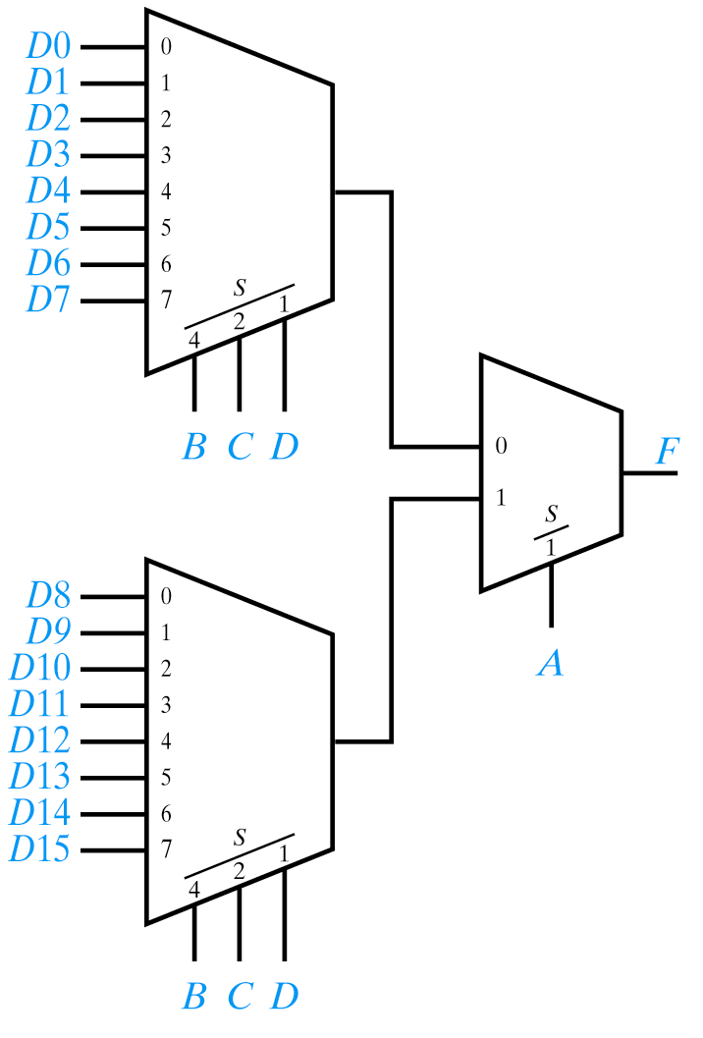
Generalizing MUX trees
A 16-to-1 MUX using 8-to-1 MUXs
Determine number of select inputs needed
2^{n} = 16, n = 4
List inputs and output in truth table order
A B C D F
Annotate with the bit weights
8 4 2 1
A B C D F
Reverse the order
8 4 2 1
A B C D F
1 2 4 8
Circled numbers indicate number of 2-to-1 muxs
and 8-to-1 muxs

Slide 20
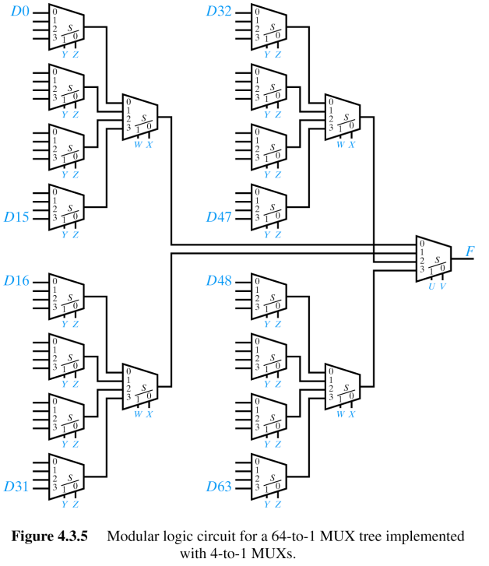
Generalizing…
A 64-to-1 MUX using 4-to-1 MUXs
Determine number of select inputs needed
2^{n} = 64, n = 6
List inputs and output in truth table order
U V W X Y Z F
Annotate with the bit weights
3216 8 4 2 1
U V W X Y Z F
Reverse the order
3216 8 4 2 1
U V W X Y Z F
1 2 4 8 1632
Circled numbers indicate number of 4-to-1 muxs

Slide 21


Slide 22
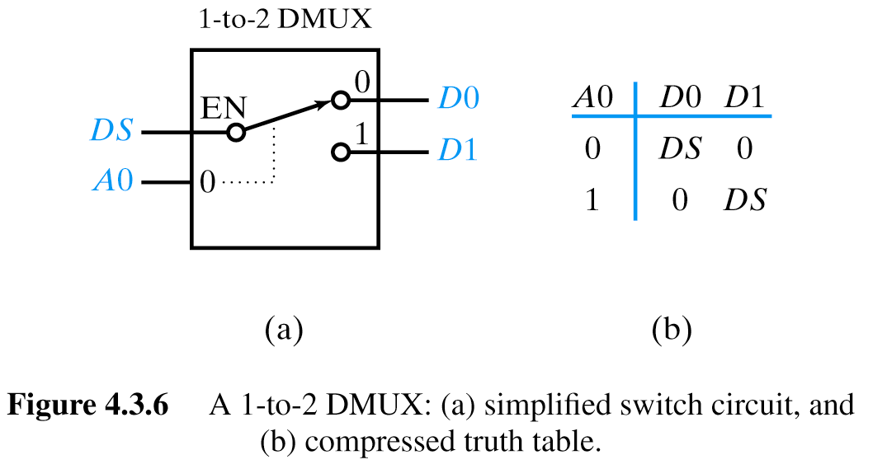
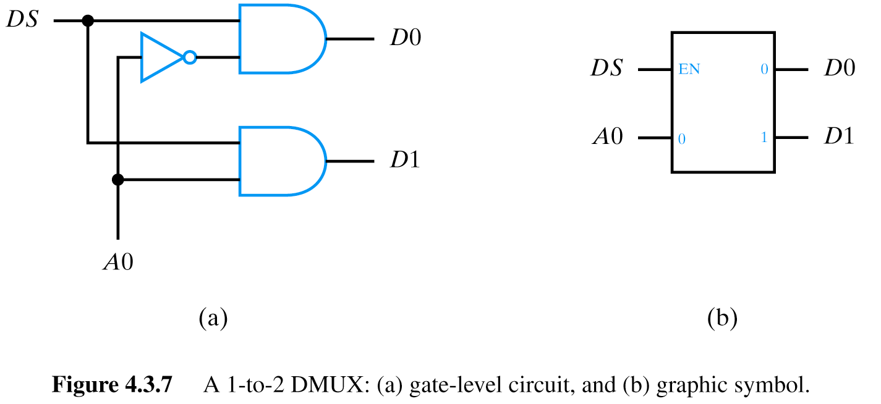
DMUXs

Slide 23
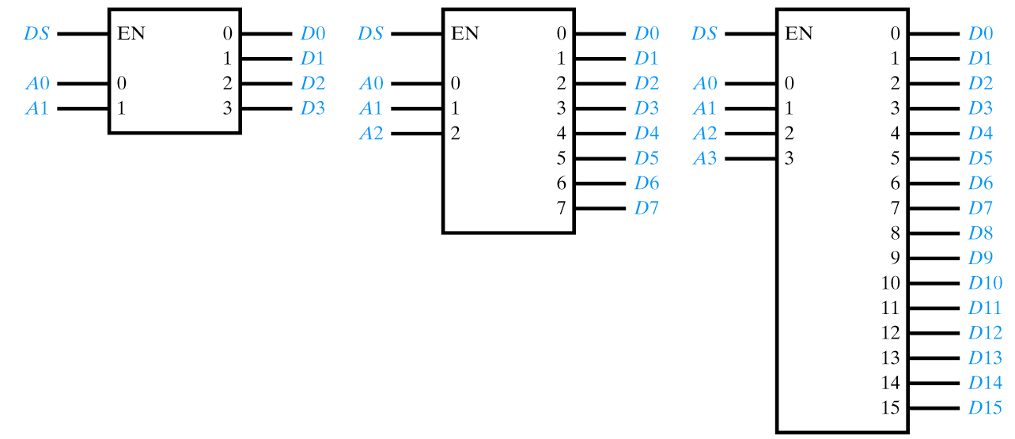
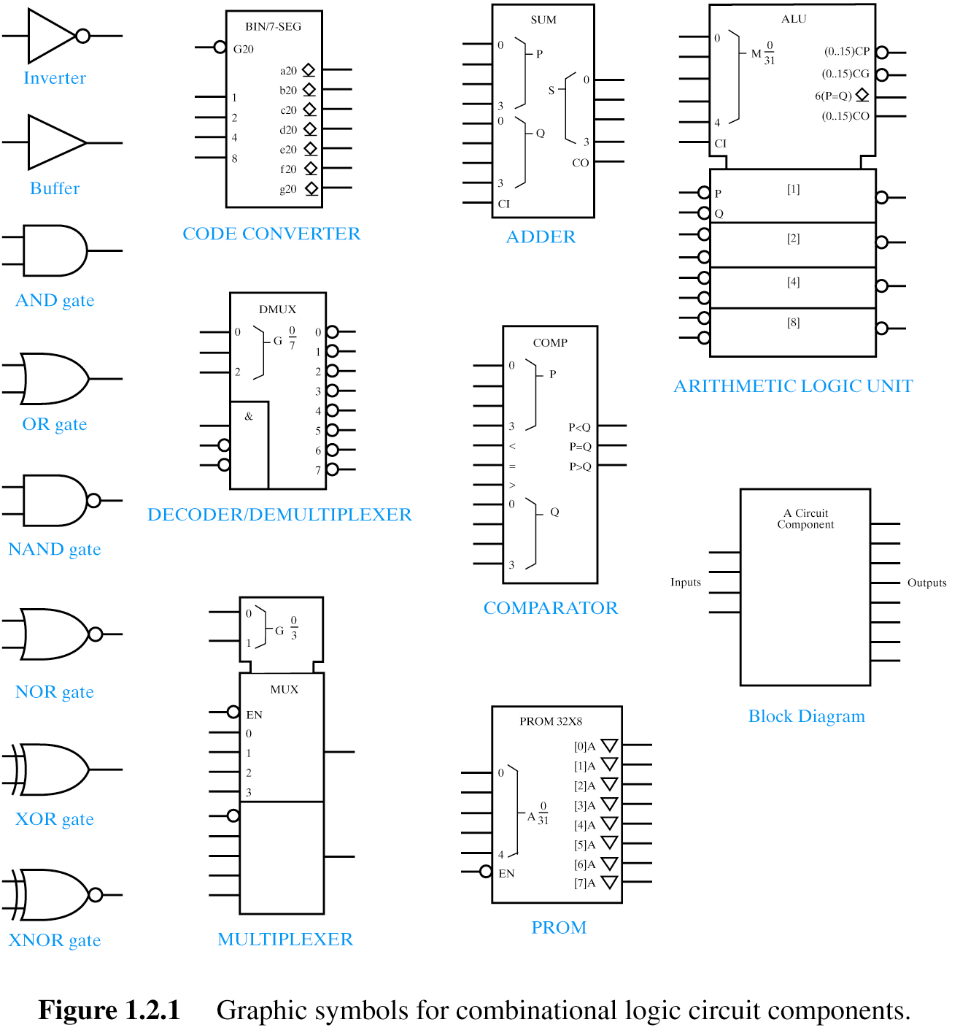
Larger DMUXs
2-to-4
3-to-8
4-to-16
Off-the-shelf devices use active L EN
Outputs also active L
3-to-8 DMUX == “1 of 8 DMUX”
1-to-2 DMUX unavailable
logic gates
use 2-to-4 dmux

Slide 24
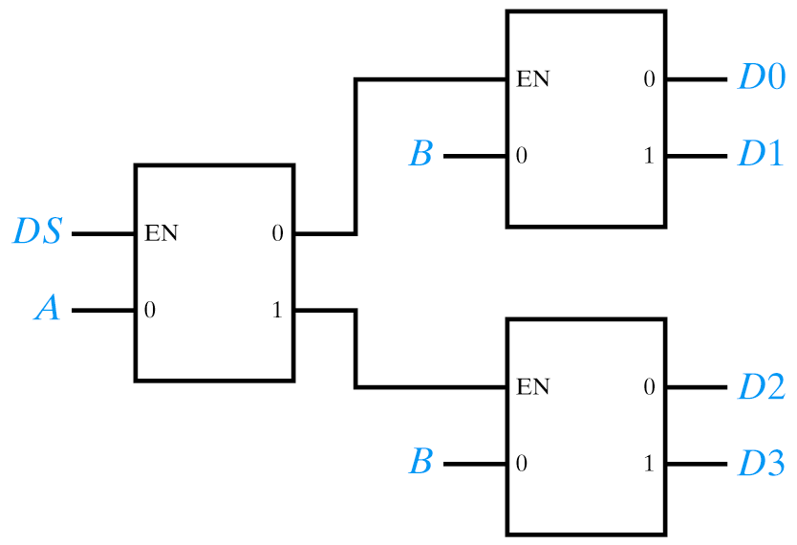
DMUX Trees
A 1-to-4 DMUX using 1-to-2 DMUXs
Determine number of address inputs needed
2^{n} = 4, n = 2
List inputs and output in truth table order
A B D0 D1 D2 D3
Annotate with the bit weights
2 1
A B D0 D1 D2 D3
Reverse the order
2 1
A B D0 D1 D2 D3
1 2
Circled numbers indicate number of 1-to-2 dmuxs

Slide 25
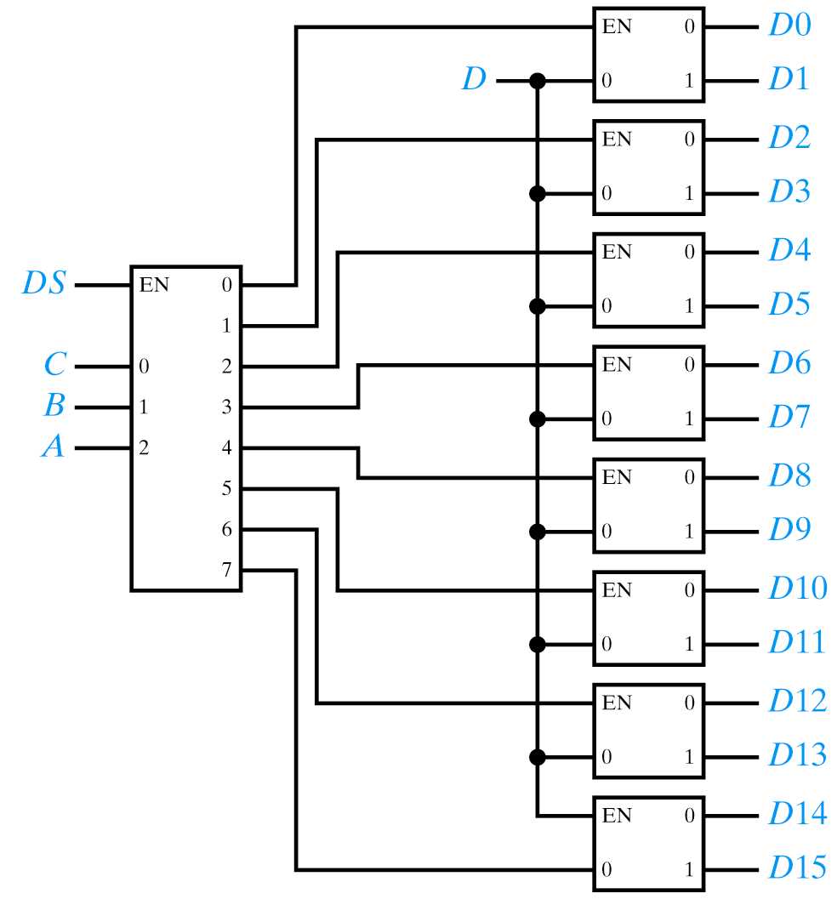
DMUX Trees
A 4-to16 DMUX
Determine number of address inputs
2⁴ = 16, n = 4
List I/Os in truth table order
A B C D D0 … D15
Annotate with the bit weights
8 4 2 1
A B C D D0 … D15
Reverse the order
8 4 2 1
A B C D D0 … D15
1 2 4 8
Circled numbers indicate number of 3-to-8 and 1-to-2 dmuxs respectively

Slide 26
XOR and XNOR

Slide 27
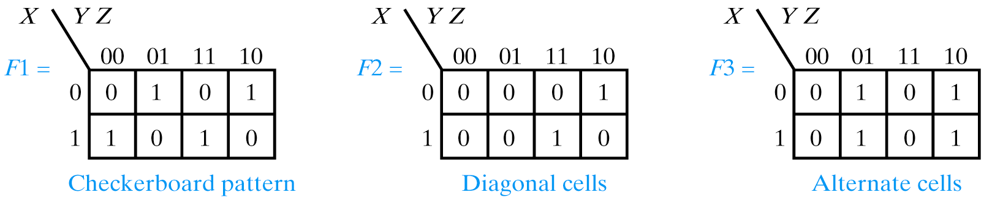
More on XOR and XNOR
Distinctive K-Map patterns indicative of XOR and XNOR

Slide 28
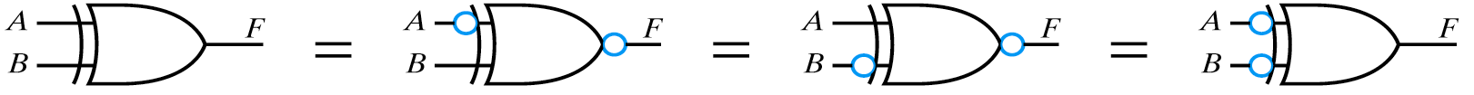
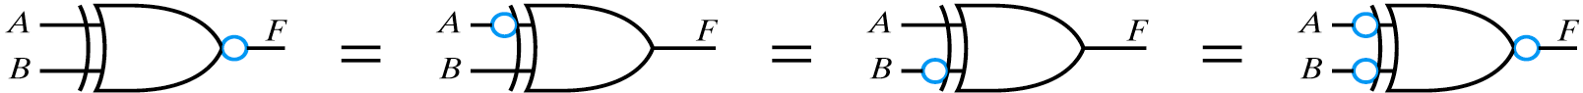
More on XOR and XNOR
Equivalent XOR Symbols
Even number of bubbles rule
Equivalent XNOR Symbols
Odd number of bubbles rule

Slide 29
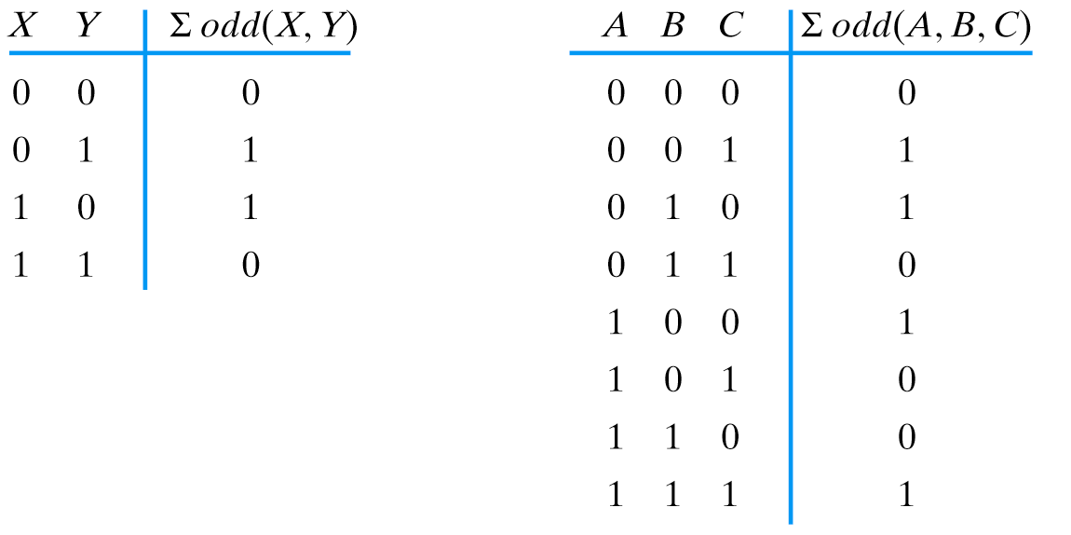
The Odd Function
XOR
XOR

Slide 30
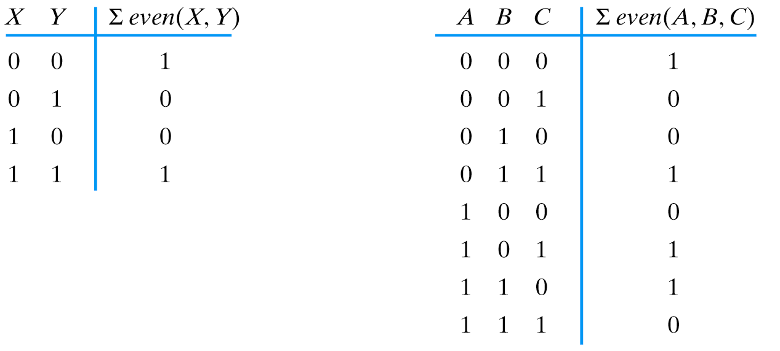
The Even Functions
XNOR
XNOR

Slide 31
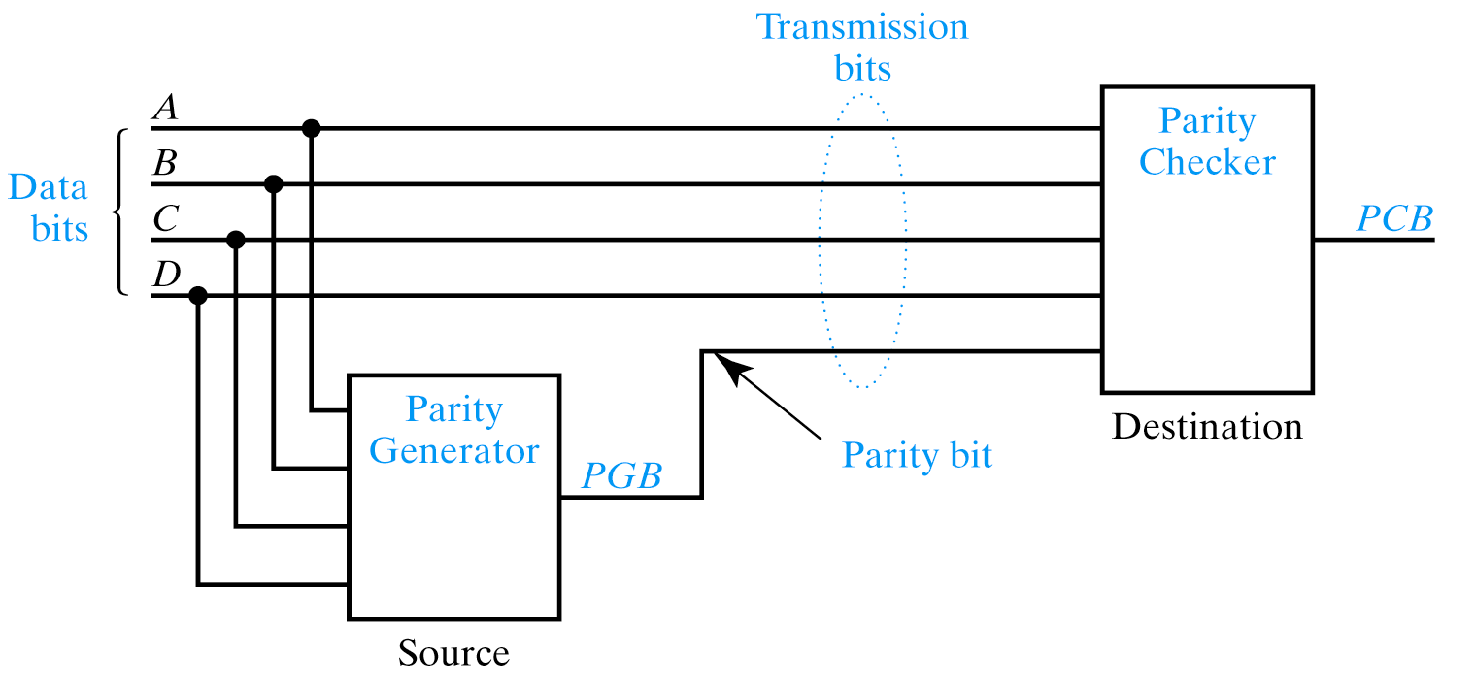
Parity
A single bit error detection scheme
Even parity: generate and transmit odd function – checker will
use odd function to detect parity error
Odd parity: generate and transmit even function – checker will
use even function to detect parity error
74LS280 example! Hamming codes

Slide 32
Parity
A single bit error detection scheme
1
1
1
1
0
0
0
1
1
1
1
Even parity: generate and transmit odd function – checker will
use odd function to detect parity error
Notes:
74LS280 example! Hamming codes

Slide 33
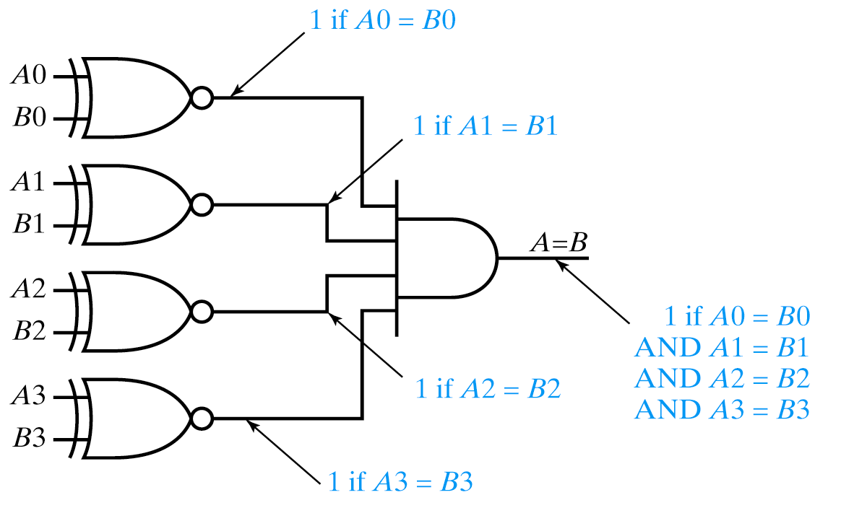
Comparators
The actual comparator also does < and >.
See also example from earlier in the book! LS686

Slide 34
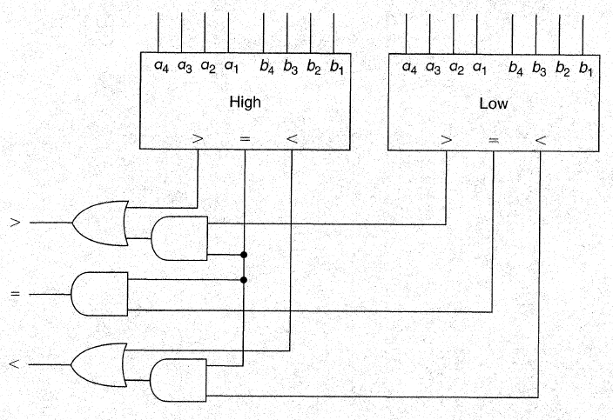
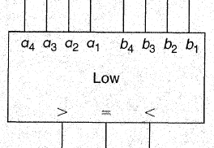
Comparators
The actual comparator also does < and >.
Non-expandable 4-bit comparator requires external logic to
construct an 8-bit comparator
Notes:
The actual comparator also does < and >. See also example from earlier in the book! LS686

Slide 35
Comparators
Expandable 4-bit comparator doesn’t require external logic to
construct an 8-bit comparator – can accept inputs from other “stage”
Notes:
The actual comparator also does < and >. See also example from earlier in the book! LS686

Slide 36
Sources
Prof. Mark G. Faust
John Wakerly

